Slide 1
CHAT CONNECT real Time CHAT AND COMMUNICATION APP
SUBMITTED BY
S.NAGARAJ
M.RAJADURAI
I.REEGAN SANTHOSH KUMAR
J.NIVETHA

Slide 2
Project Description:
Chat Connect is a sample project built using the Android Compose UI toolkit. It demonstrates how to create a simple chat app using the Compose libraries. The app allows users to send and receive text messages. The project showcases the use of Compose declarative UI and state management capabilities. It also includes examples of how to handle input and navigation using compo sable functions and how to use data from a firebase to populate the UI.

Slide 3
To Complete this project we need to finish up the following steps:
Required initial steps
Creating a new project
Adding required dependicies
Creating a database classes
Building application UI and connecting to database
Using android manifest.XML
Running the application

Slide 4
Main activity Java:
# Default ignored files
/shelf/
/workspace.xml
<?xml version="1.0" encoding="UTF-8"?><project version="4"> <component name="GradleSettings"> <option name="linkedExternalProjectsSettings"> <GradleProjectSettings> <option name="testRunner" value="GRADLE" /> <option name="distributionType" value="DEFAULT_WRAPPED" /> <option name="externalProjectPath" value="$PROJECT_DIR$" /> </GradleProjectSettings> </option> </component></project>

Slide 5
<?
xml version="1.0" encoding="UTF-8"?
<project version="4"> <component name="ExternalStorageConfigurationManager" enabled="true" />
<component name="ProjectRootManager" version="2" languageLevel="JDK_11" default="true" project-jdk-name="Android Studio default JDK" project-jdk-type="JavaSDK">
<output url="file://$PROJECT_DIR$/build/classes" /> </component> <component name="ProjectType"> <option name="id" value="Android" /> </component></project>

Slide 6
plugins {
id 'com.android.application’
id 'kotlin-android’
id 'com.google.gms.google-services
android {
compileSdk 30
defaultConfig {
applicationId "com.project.pradyotprakash.flashchat"
minSdk 21
targetSdk 30
versionCode 1
versionName "1.0"

Slide 7
testInstrumentationRunner“android x.test.runner.AndroidJUnitRunner" vectorDrawables {
useSupportLibrary true
}
}
buildTypes {
release {
minifyEnabled false
proguardFiles getDefaultProguardFile('proguard-android-optimize.txt'), 'proguard-rules.pro'
}
}
CompileOption {
so urceCompatibility JavaVersion.VERSION_1_8
targetCompatibility JavaVersion.VERSION_1_8
}

Slide 8
kotlinOptions {
jvmTarget = '1.8'
useIR = true
}
buildFeatures {
compose true
}
composeOptions {
kotlinCompilerExtensionVersion compose_version
kotlinCompilerVersion '1.5.10’
}
packagingOptions {
resources {
ex cludes += '/META-INF/{AL2.0,LGPL2.1}'
}
}
}

Slide 9
dependencies {
implementation 'androidx.core:core-ktx:1.6.0’
implementation 'androidx.appcompat:appcompat:1.3.1’
implementation 'com.google.android.material:material:1.4.0’
implementation "androidx.compose.ui:ui:$compose_version"
implementation "androidx.compose.material:material:$compose_version"
implementation "androidx.compose.ui:ui-tooling-preview:$compose_version"
implementation 'androidx.lifecycle:lifecycle-runtime-ktx:2.3.1’
implementation 'androidx.activity:activity-compose:1.3.1'
implementation 'androidx.lifecycle:lifecycle-livedata-ktx:2.3.1'
implementation 'androidx.lifecycle:lifecycle-viewmodel-ktx:2.3.1’
implementation "androidx.compose.runtime:runtime-livedata:$compose_version"
implementation 'androidx.lifecycle:lifecycle-viewmodel-compose:1.0.0-alpha07'

Slide 10
implementation "androidx.navigation:navigation-compose:2.4.0-alpha06"
implementation platform('com.google.firebase:firebase-bom:28.3.0’)
implementation 'com.google.firebase:firebase-analytics-ktx’
Implementation 'com.google.firebase:firebase-auth-ktx'
implementation 'com.google.firebase:firebase-firestore-ktx'
implementation 'com.google.firebase:firebase-auth:21.0.3’
implementation 'com.google.firebase:firebase-firestore:24.1.1’
testImplementation 'junit:junit:4.13.2’
androidTestImplementation 'androidx.test.ext:junit:1.1.3’
androidTestImplementation 'androidx.test.espresso:espresso-core:3.4.0’
androidTestImplementation "androidx.compose.ui:ui-test-junit4:$compose_version"
debugImplementation "androidx.compose.ui:ui-tooling:$compose_version“
}

Slide 11
distributionBase=GRADLE_USER_HOME istributionUrl=https\://services.gradle.org/distributions/gradle-7.0.2-bin.zip
distributionPath=wrapper/dists
zipStorePath=wrapper/
Distribution zipStoreBase=GRADLE_USER_HOME
*.iml
.Gradle
/local.properties
/.idea/caches
/.idea/libraries
/.idea/modules.xml
/.idea/workspace.xml
/.idea/navEditor.xml
/.idea/assetWizardSettings.xml
.DS_Store
/build
/captures
.externalNativeBuild
.cxx
local.properties

Slide 12
// Top-level build file where you can add configuration options common to all sub-projects/modules. Buildscript { ext { compose_version = ‘1.0.1’ } repositories { google() mavenCentral() } dependencies { classpath “com.android.tools.build:gradle:7.0.0" classpath "org.jetbrains.kotlin:kotlin-gradle-plugin:1.5.21" classpath "com.google.gms:google-services:4.3.8" // NOTE: Do not place your application dependencies here; they belong // in the individual module build.gradle files

Slide 13
}
}
task clean(type: Delete) {
delete rootProject.buildDir
}
PRG="$0“
while [ -h "$PRG" ] ; do
ls=`ls -ld "$PRG"`
link=`expr "$ls" : '.*-> \(.*\)$’
if expr "$link" : '/.*' > /dev/null; then
PRG="$link"
else
PRG=`dirname "$PRG"`"/$link"
fi
Done
SAVED="`pwd`“
cd "`dirname \"$PRG\"`/" >/dev/null
APP_HOME="`pwd -P`“
cd "$SAVED" >/dev/
nullAPP_NAME="Gradle"APP_BASE_NAME=`basename "$0"`

Slide 14
DEFAULT_JVM_OPTS='"-Xmx64m" "-Xms64m"'
MAX_FD="maximum“
Warn () {
echo "$*“
}
Die () {
echo
echo "$*"
echo
exit 1
}
Cygwin=false
darwin=false
nonstop=false
case "`uname`" in
CYGWIN* )
cygwin=true
;;
Darwin* )
darwin=true
;;

Slide 15
MINGW* )
msys=true
;;
NONSTOP* )
nonstop=true
;;
esac
CLASSPATH=$APP_HOME/gradle/wrapper/gradle-wrapper.jar
if [ -n "$JAVA_HOME" ] ; then
V if [ -x "$JAVA_HOME/jre/sh/java"

Slide 16
JAVACMD="$JAVA_HOME/jre/sh/java"
else
JAVACMD="$JAVA_HOME/bin/java"
fi
if [ ! -x "$JAVACMD" ] ; then
die "ERROR: JAVA_HOME is set to an invalid directory: $JAVA_HOME
Please set the JAVA_HOME variable in your environment to match the
Location of your Java installation."
fi
JAVACMD="java"
which java >/dev/null 2>&1 || die
"ERROR: JAVA_HOME is not set and no 'java' command could be found in your PATH.
set the JAVA_HOME variable in your environment to match the
Location of your Java installation."

Slide 17
for arg in "$@" ; do
CHECK=`echo "$arg"|egrep -c
"$OURCYGPATTERN" -`
CHECK2=`echo "$arg"|egrep -c "^-"`
if [ $CHECK -ne 0 ] && [ $CHECK2 -eq 0 ] ; then
eval `echo args$i`=`cygpath --path --ignore --mixed "$arg"` else
eval `echo args$i`="\"$arg\"" fi
i=`expr $i + 1` done case $i in
0) set -- ;;
1) set -- "$args0" ;;
2) set -- "$args0" "$args1" ;;
3) set -- "$args0" "$args1" "$args2" ;;
. 4) set -- "$args0" "$args1" "$args2" "$args3" ;;
5) set -- "$args0" "$args1" "$args2" "$args3" "$args4" ;;
6) set -- "$args0" "$args1" "$args2" "$args3" "$args4" "$args5" ;;
7) set -- "$args0" "$args1" "$args2" "$args3" "$args4" "$args5" "$args6" ;;
8) set -- "$args0" "$args1" "$args2" "$args3" "$args4" "$args5" "$args6" "$args7" ;;
9) set -- "$args0" "$args1" "$args2" "$args3" "$args4" "$args5" "$args6" "$args7" "$args8" ;; esac

Slide 18
:findJavaFromJavaHomeset
JAVA_HOME=%JAVA_HOME:"=%set JAVA_EXE=%JAVA_HOME%/bin/java.exeif
Exist
"%JAVA_EXE%" goto executeecho.echo ERROR:
JAVA_HOME is set to an invalid directory:
%JAVA_HOME%echo.
echo
Please set the JAVA_HOME variable in your environment to match thee
echo
Location of your Java installation.got
fail:execute
@rem

Slide 19
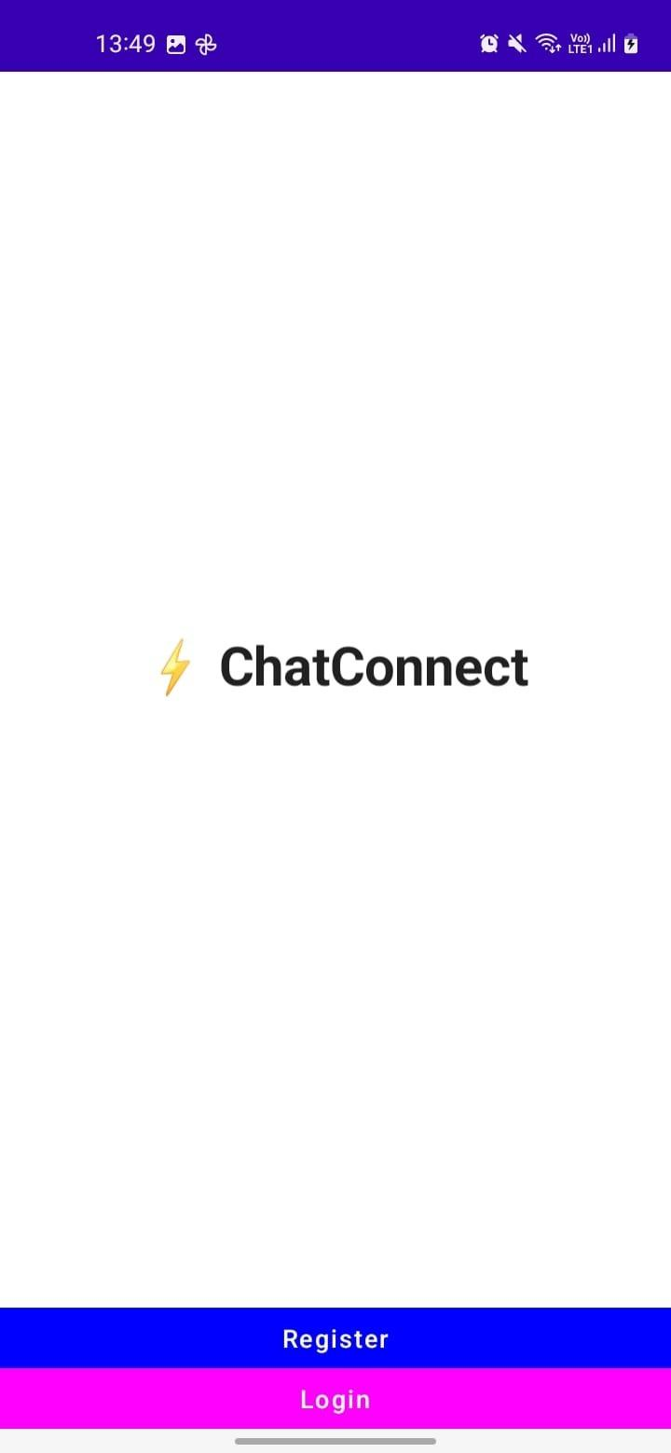

Slide 20
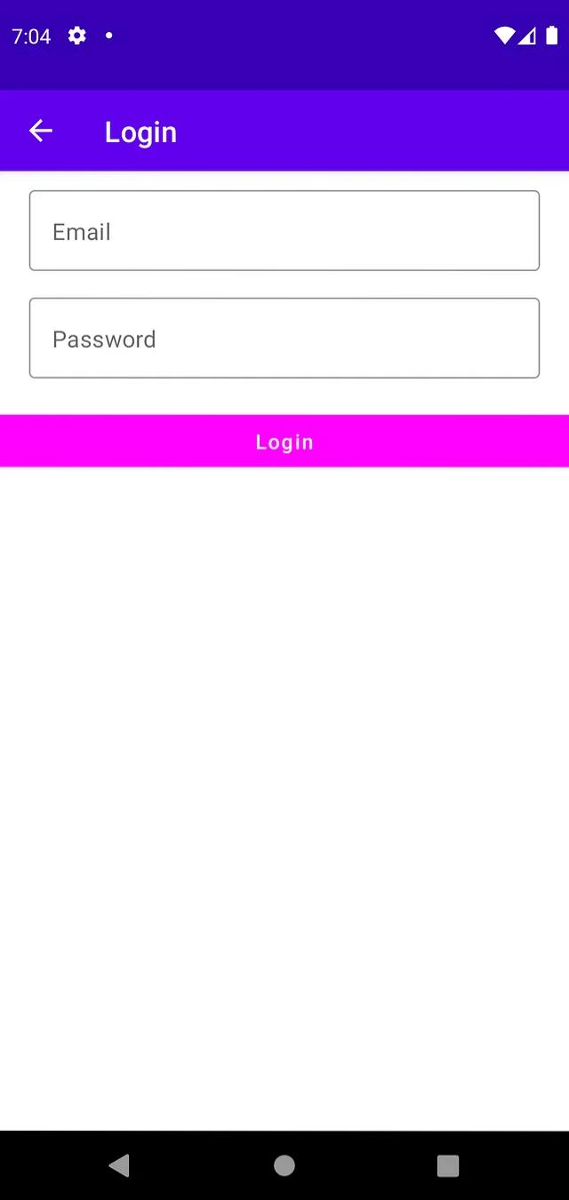

Slide 21
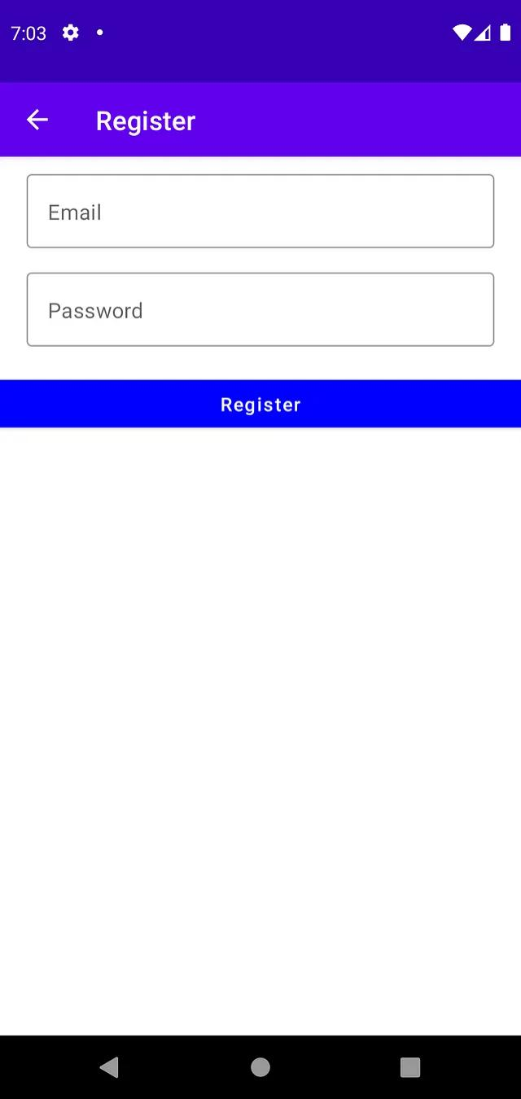

Slide 22
